Slide 1
MI Tracker
Time Tracker
Track daily activity on day to day basis
MIR
Register/Add request
Workflow
Workflow has a process of request flow raised at above stage, From Unapproved to Completed/Rejected
OT Tracker
Record overtime and track it
Error Tracker
Record Error raised by BU
Feedback Tracker
Record Feedback of BU on Report (Standard Question the BU need to provide feedback on Report in order to analysis the effectiveness of Report)
Internal Task Tracker
Add Question, that will be responded by MI team (it will be like survey)
Leave Tracker
Add leave date and it’s type to calculate utilization
Fun Activity Tracker
Add Appreciation, Up coming Activity, Activity Result

Slide 2
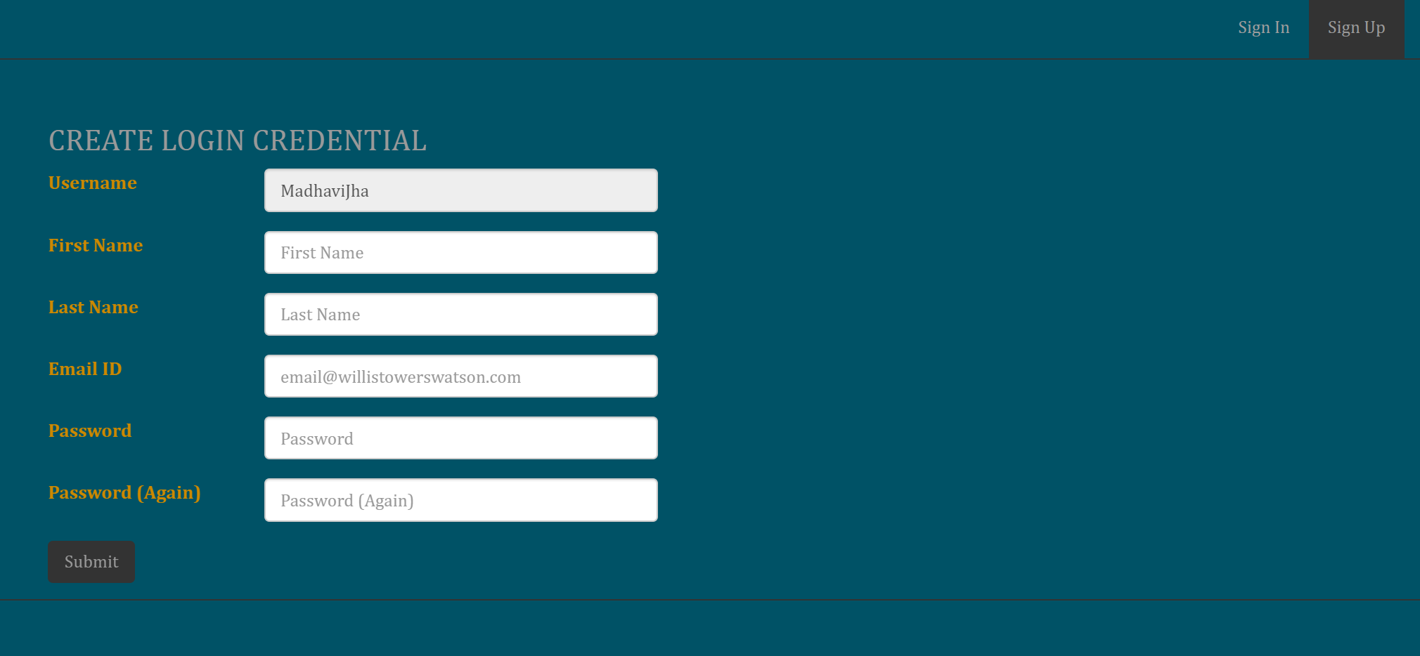
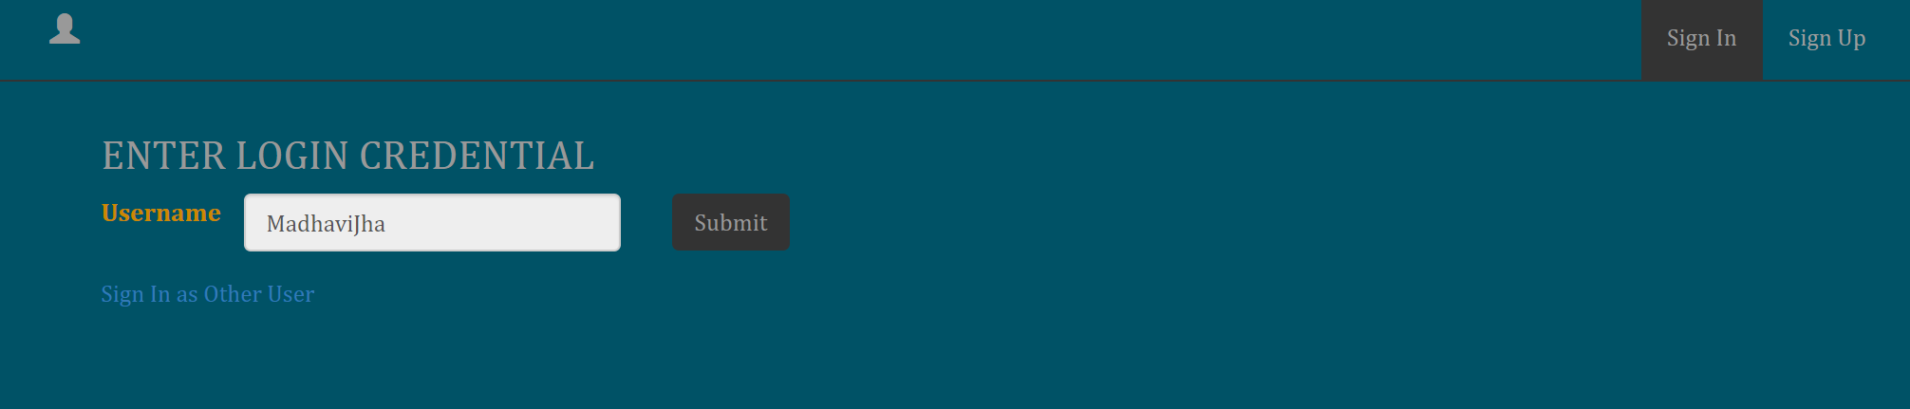
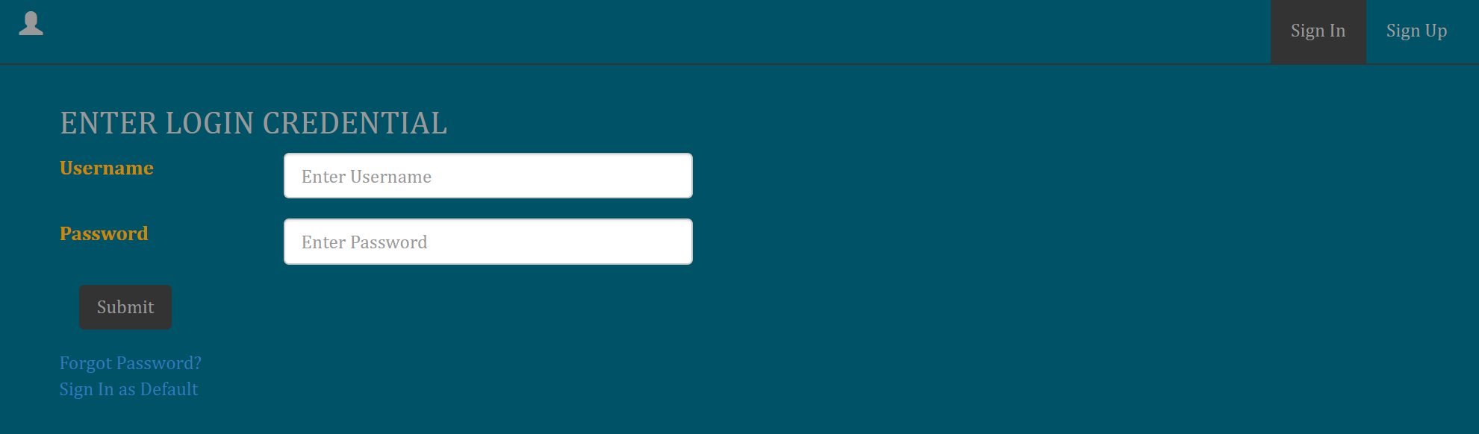
User can Signup with default user name of their Computer, username of pc automatically get’s populated in the form, it will not allow to create again if the account has been already been created
Once account created no need to remember password directly login from username, however username auto populated from Computer username and can’t be edited, so user just need to click submit button
However if user want to login with different, they can do so by click link ‘Sign in as other User’ however in such case password required.

Slide 3
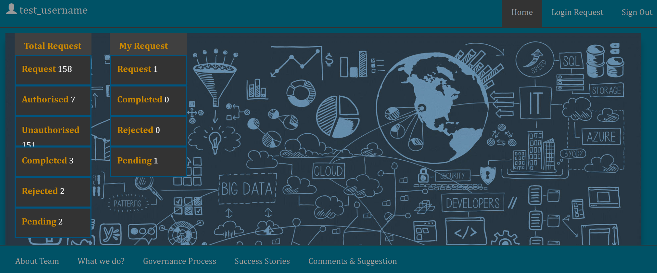
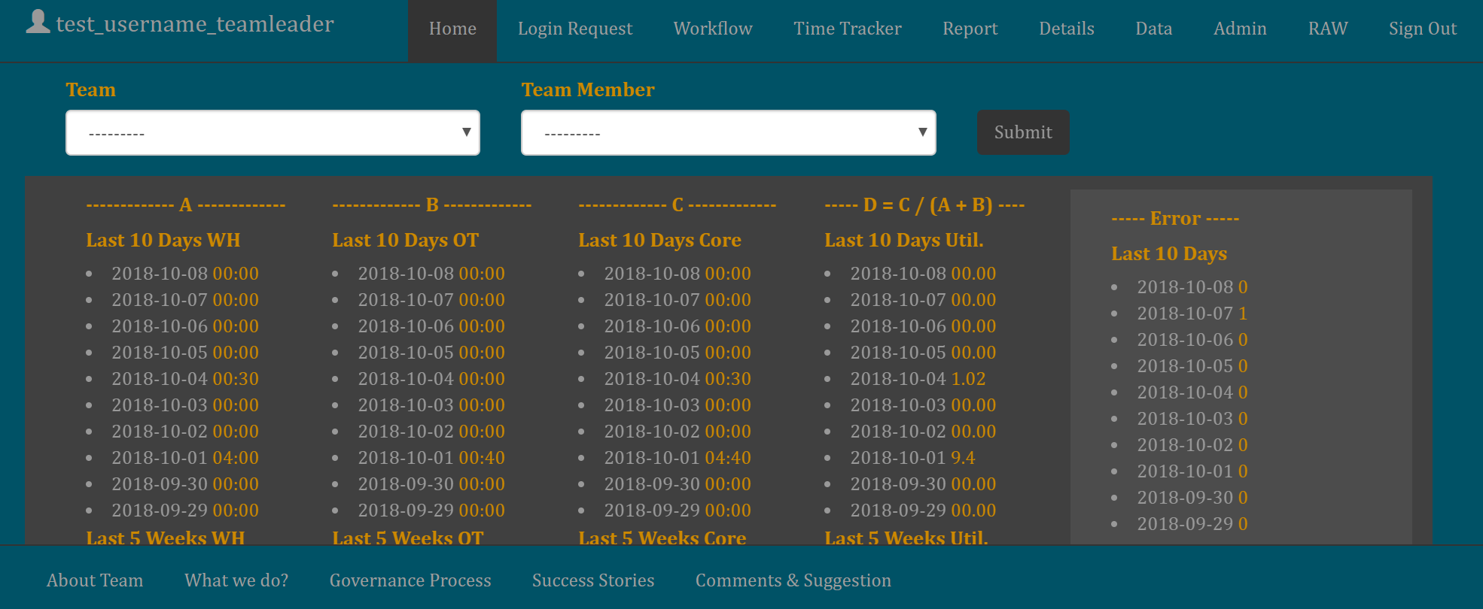
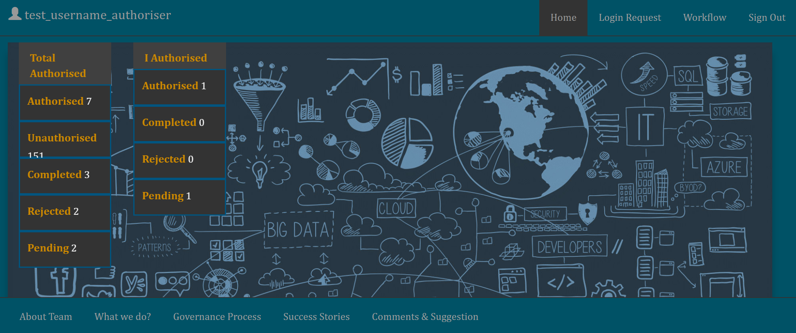
Home
Login Request
Workflow
Time-Tracker
Report
Details
Data
Admin
RAW
This the view when user create his account
This the view when user assigned under Mi team member, Team Leader, Technical Leader or Manager group, however there is restriction on Add/Edit feature accordingly
View 3
View 1
This the view when user assigned under authoriser group
View 2

Slide 4
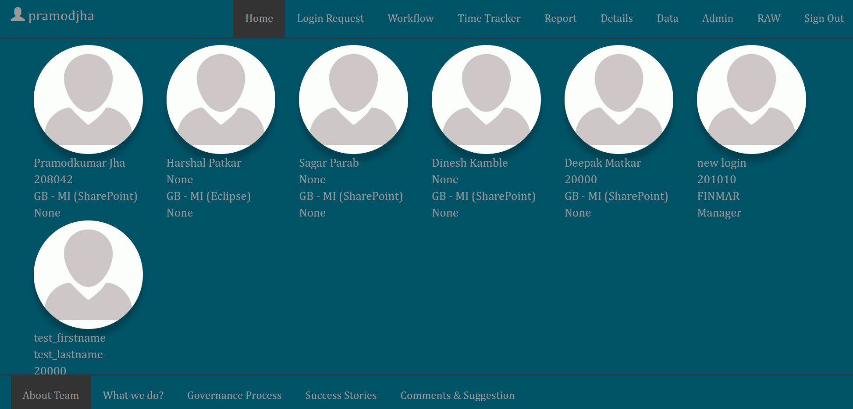
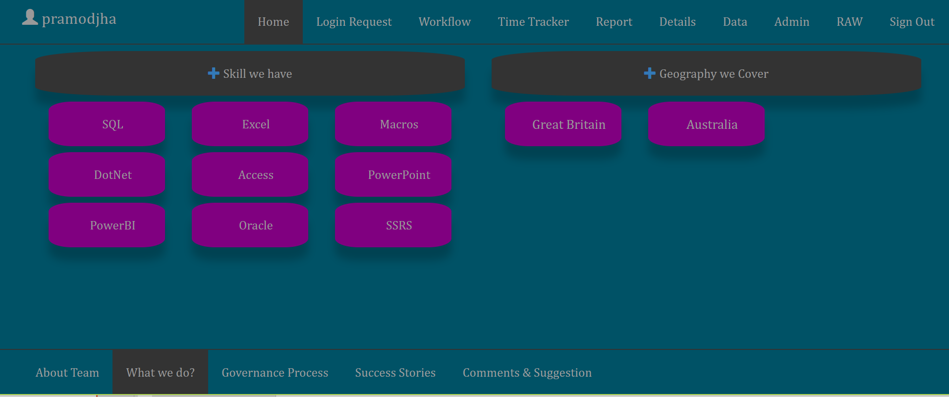
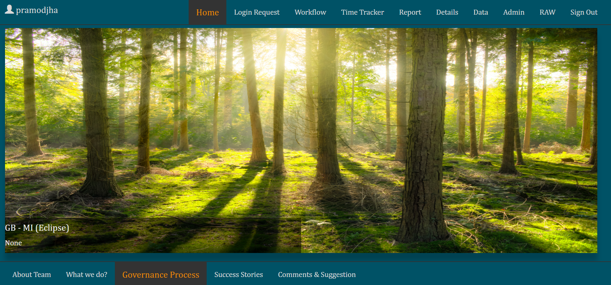
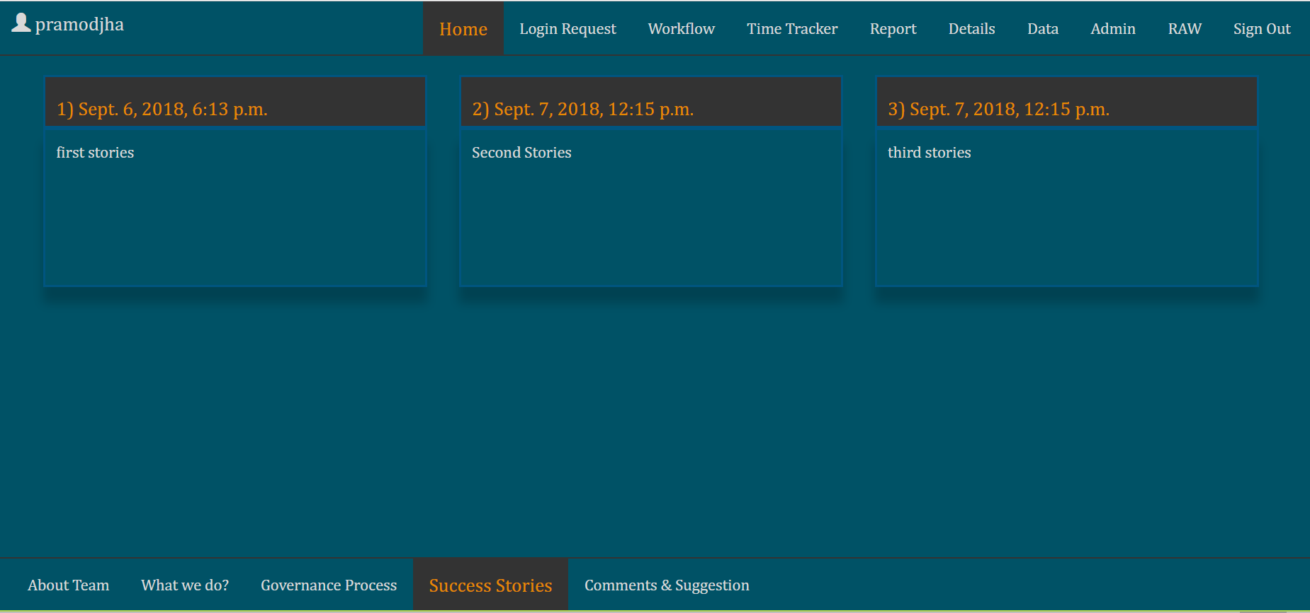
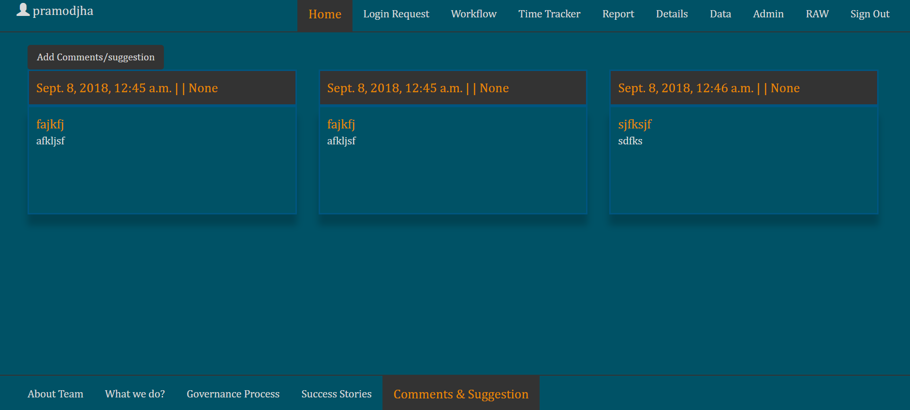
Home
Login Request
Workflow
Time-Tracker
Report
Details
Data
Admin
RAW
This will same for all view (however only edit or add function depends on access)

Slide 5
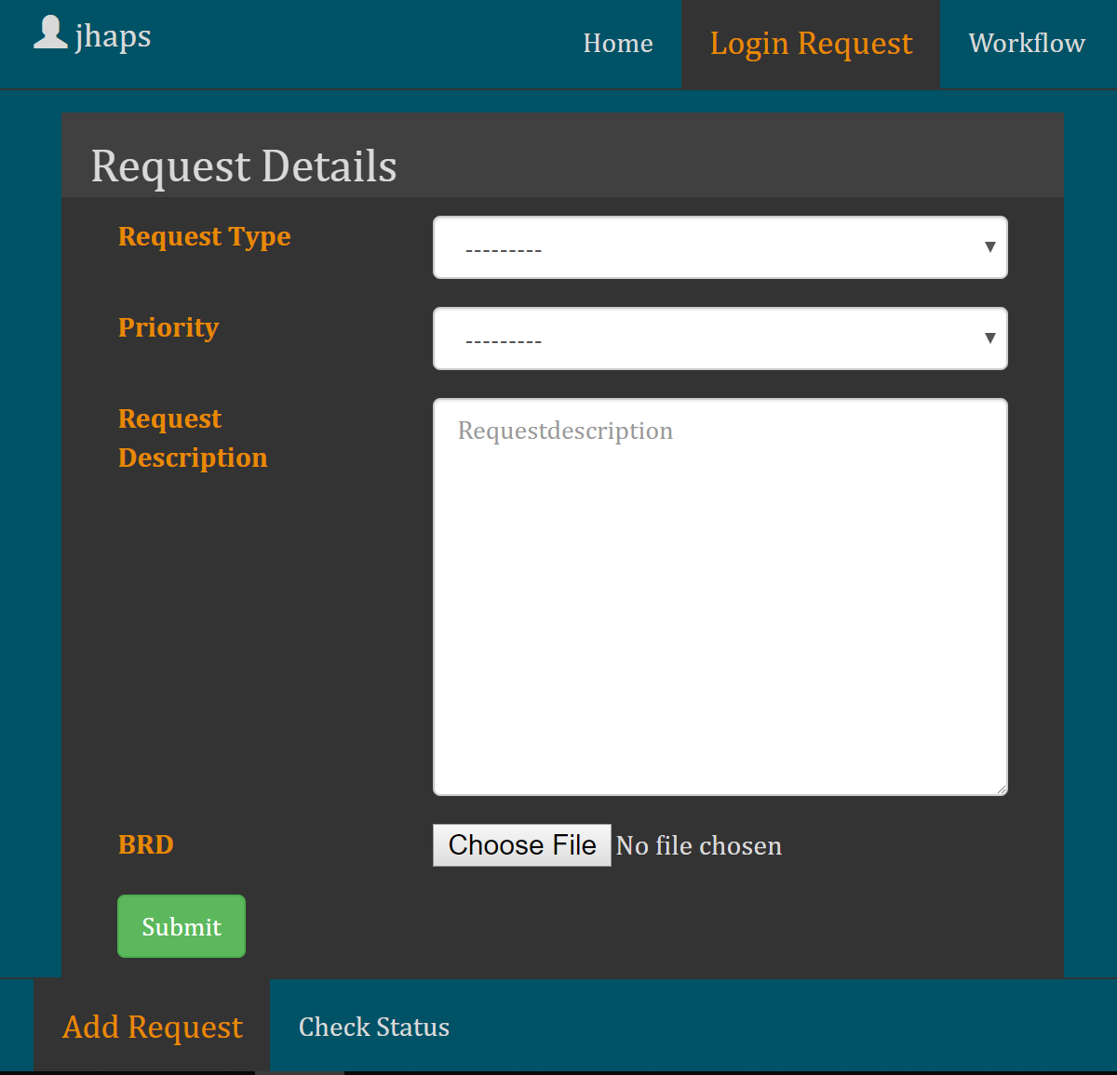
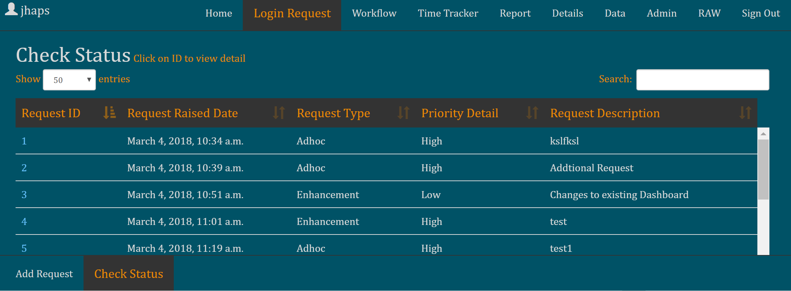
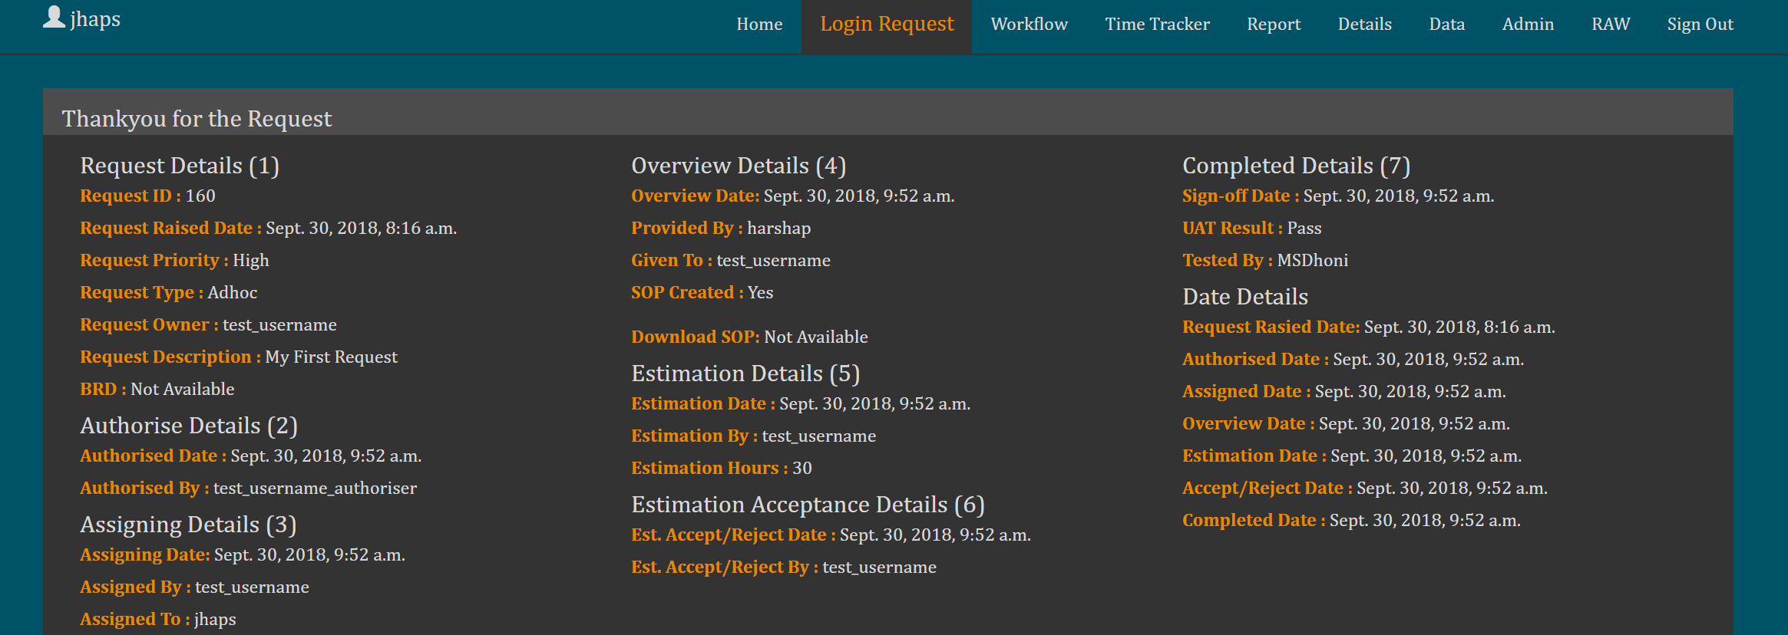
Home
Login Request
Workflow
Time-Tracker
Report
Details
Data
Admin
RAW
Check Status view is given list down the all specific id raised by user, on click of id they can check the status.
Add request, form available in every view
On click of ‘id’ one can check the status of there request, they will root to this page.
Also can view/add conversation on request by BU or MI

Slide 6
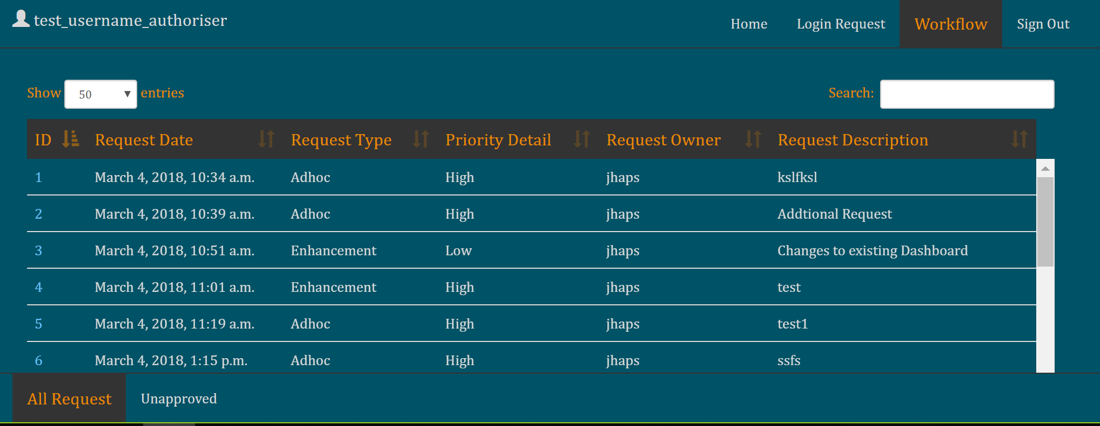
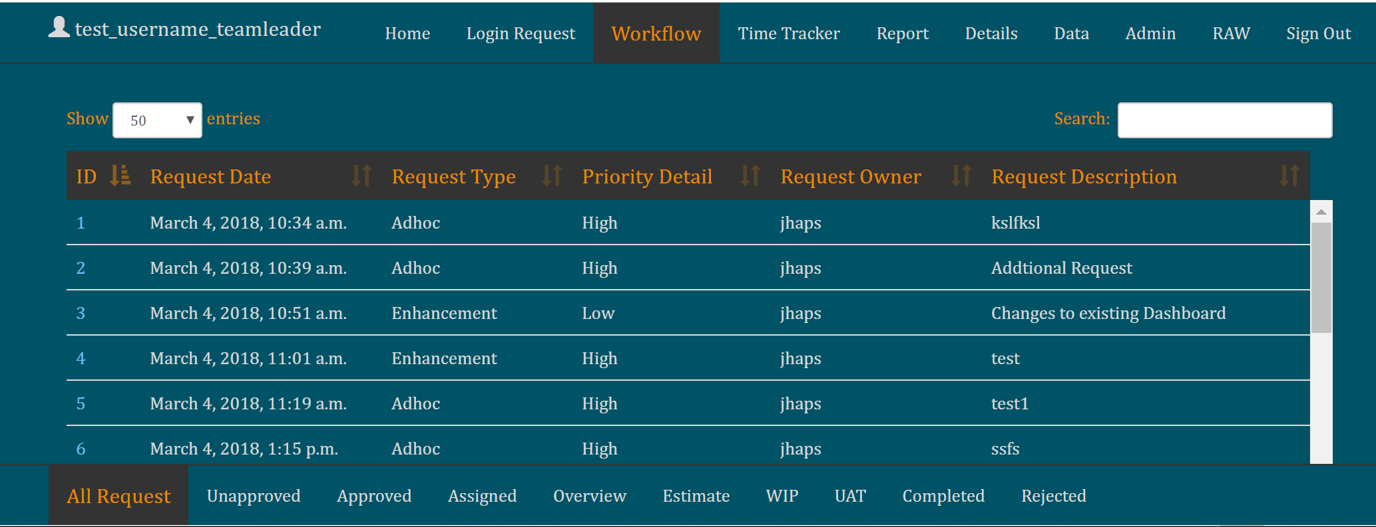
Home
Login Request
Workflow
Time-Tracker
Report
Details
Data
Admin
RAW
Team/manager/TL View:
Note: Can view unapproved request but can’t authorize.
Authoriser View:
Authoriser can view only All request, unapproved tab under Workflow

Slide 7
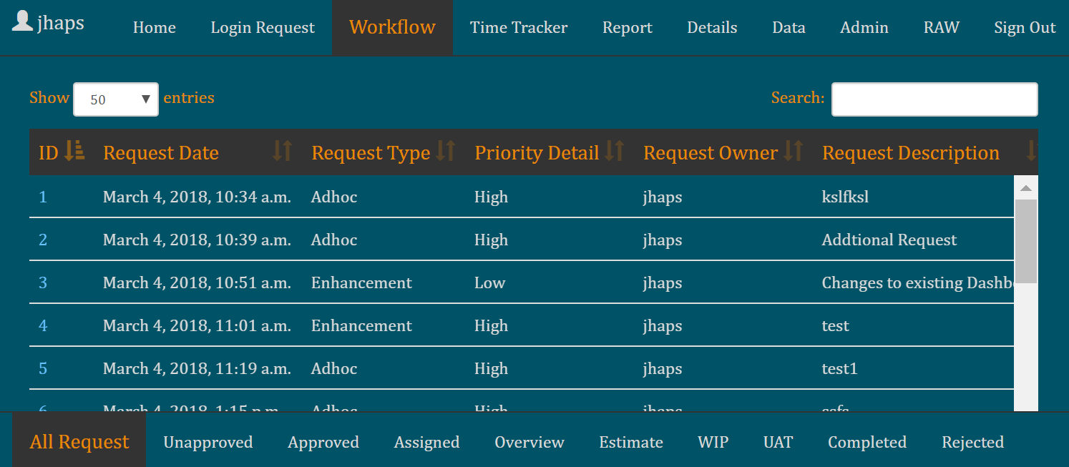
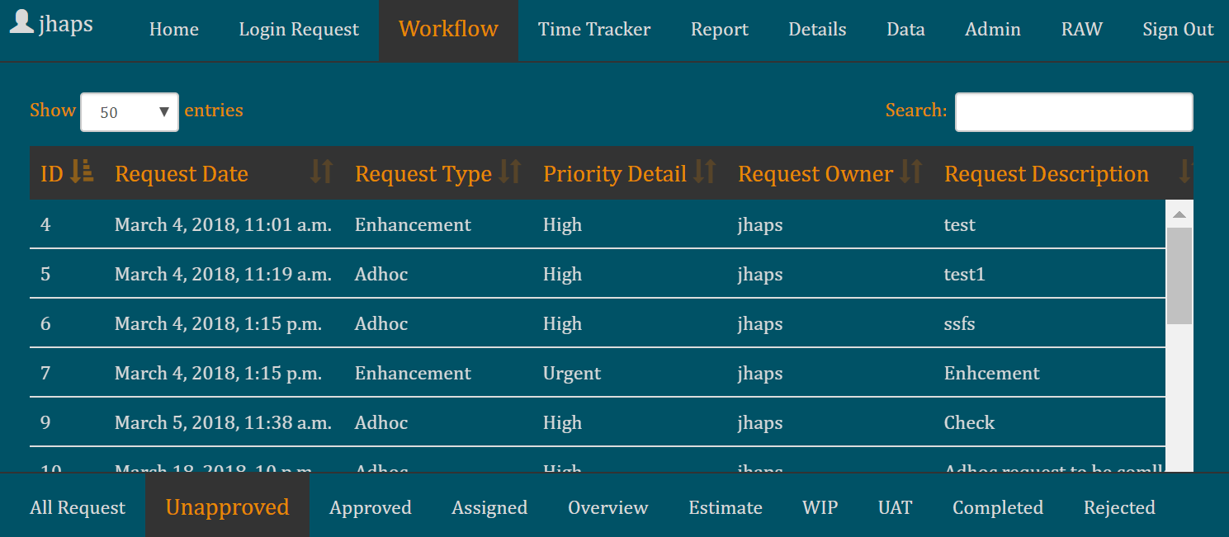
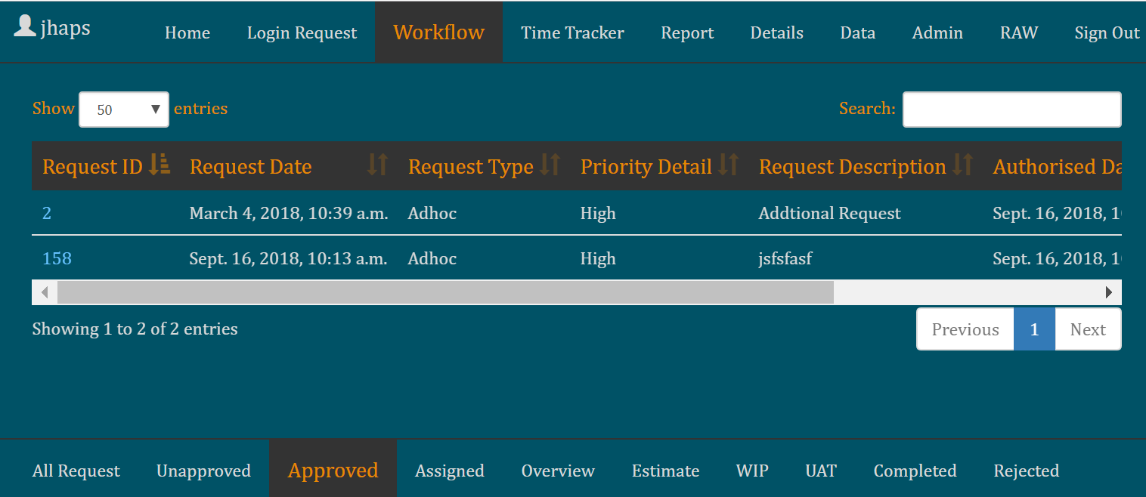
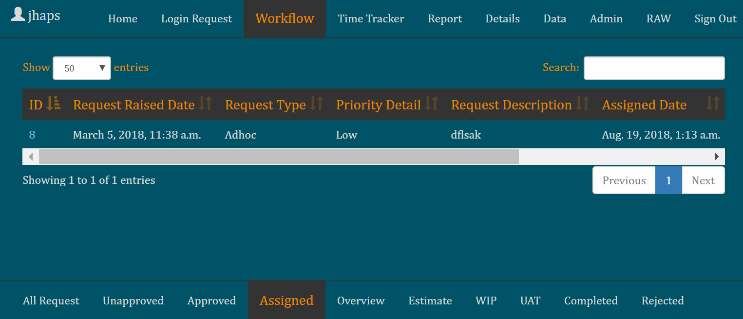
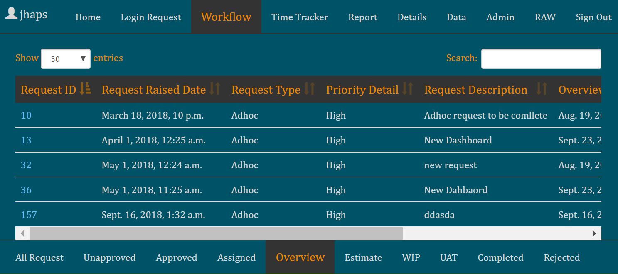
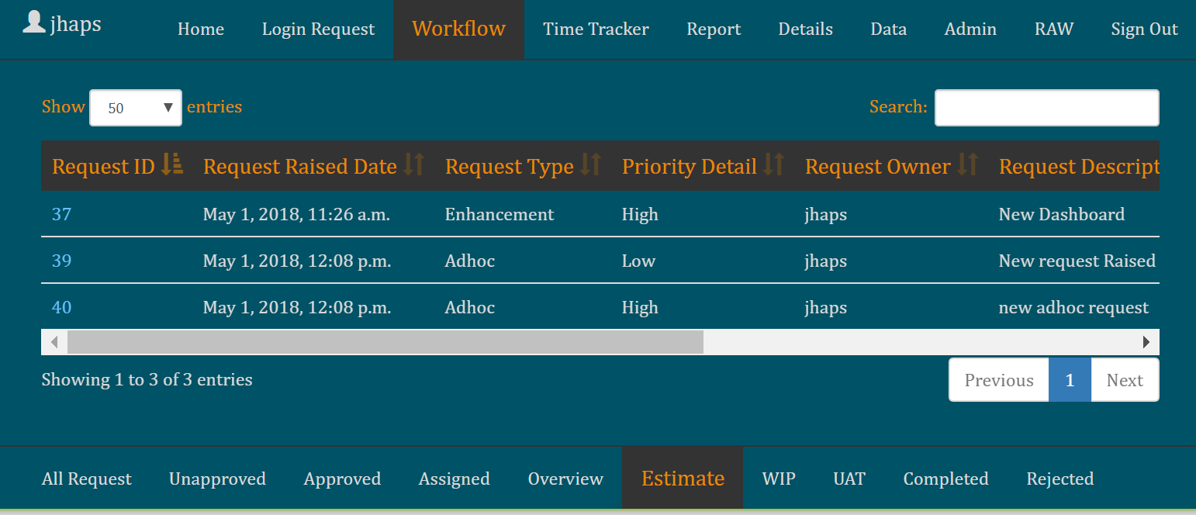
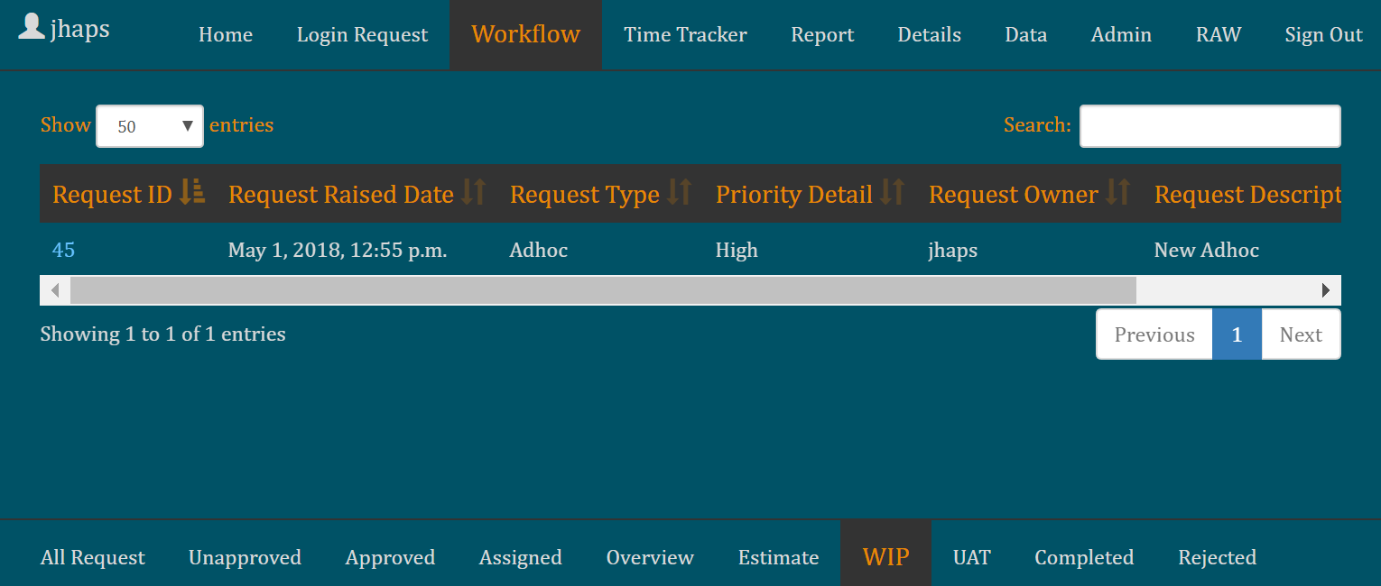
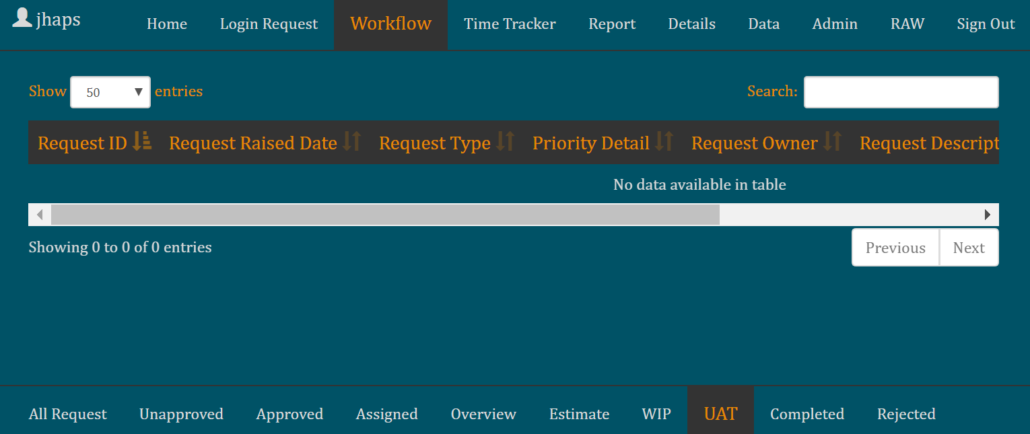
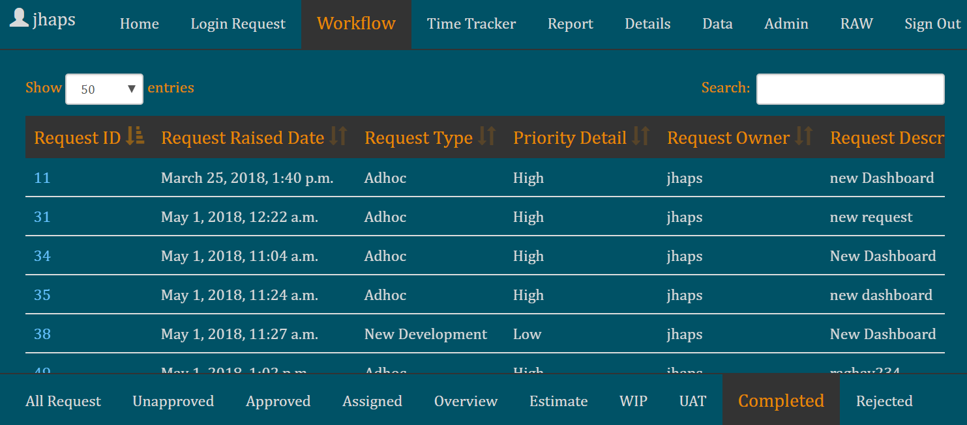
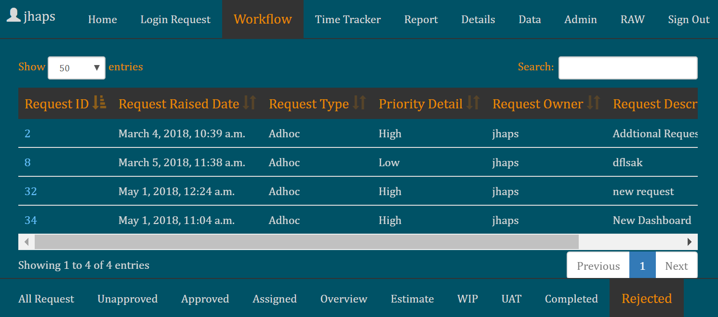
Home
Login Request
Workflow
Time-Tracker
Report
Details
Data
Admin
RAW
Above are the screenshot of the flow by which a request will move.
Each stages has an id linked with form which can be use to move the request to next stage.

Slide 8
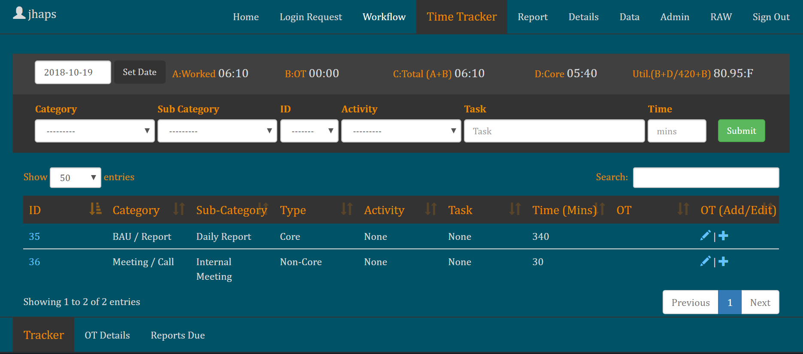
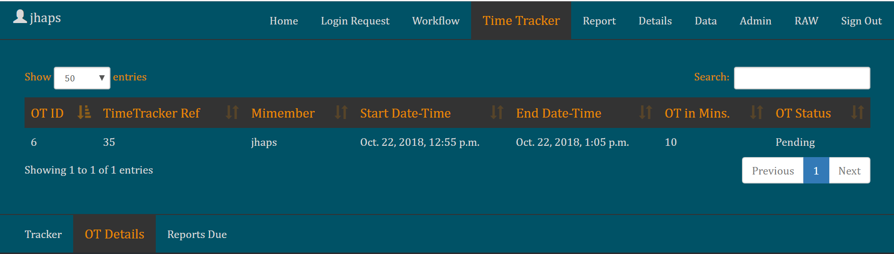
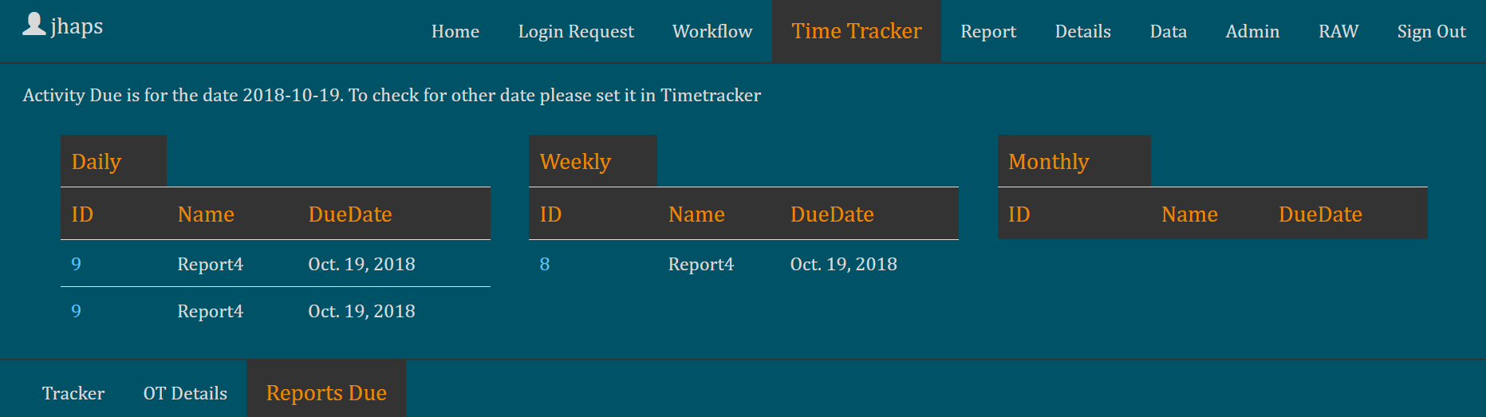
Home
Login Request
Workflow
Time-Tracker
Report
Details
Data
Admin
RAW
Tracker Tab:
It’s a time tracker, user need to set the date for which they need to track.
Once done select appropriate Category, Sub Category, Time (in mins ) then click submit, mentioned field are mandatory.
ID is option select if you have worked on specific request raised by BU.
Activity is optional, select if you have worked on specific reports/activity
The letter specified after utilization % indicate status of user ( ‘L’ indicate Leave, ‘H’ indicate Half Day, ‘F’ indicate Full day, accordingly utilization % calculate)
OT Details:
You will find all the OT records raised by team in this tab, When anyone raised OT, it will be in ‘Pending ‘ Status. Authorizer need to Accept/Reject the OT. Team member cannot change OT details once it has been Accepted/Rejected by Authorizer.
Once the authorizer perform action, OT time will appear at the “Tracker” header depending on the condition, Condition is (If accepted it will add in ‘B.OT’ otherwise it will consider the OT raised as invalid)
Report Due:
Report due show the report due for the day, you can directly add the reports from Report Due tab to Time tracker, click on report due id and form will appear you can directly add by provide the time you have spent on completing the report it will add to the time-tracker,

Slide 9
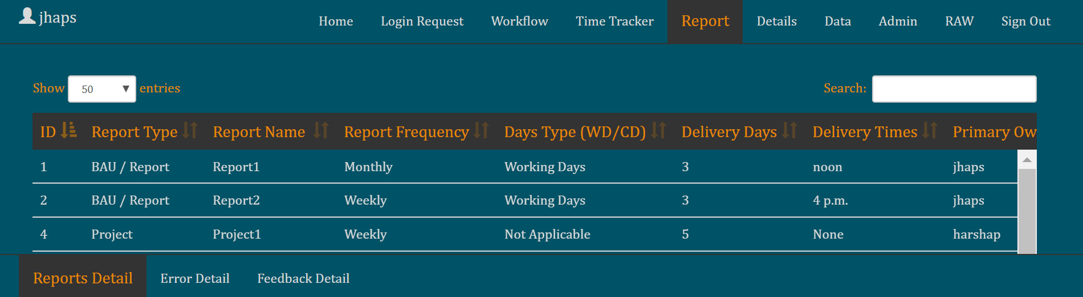
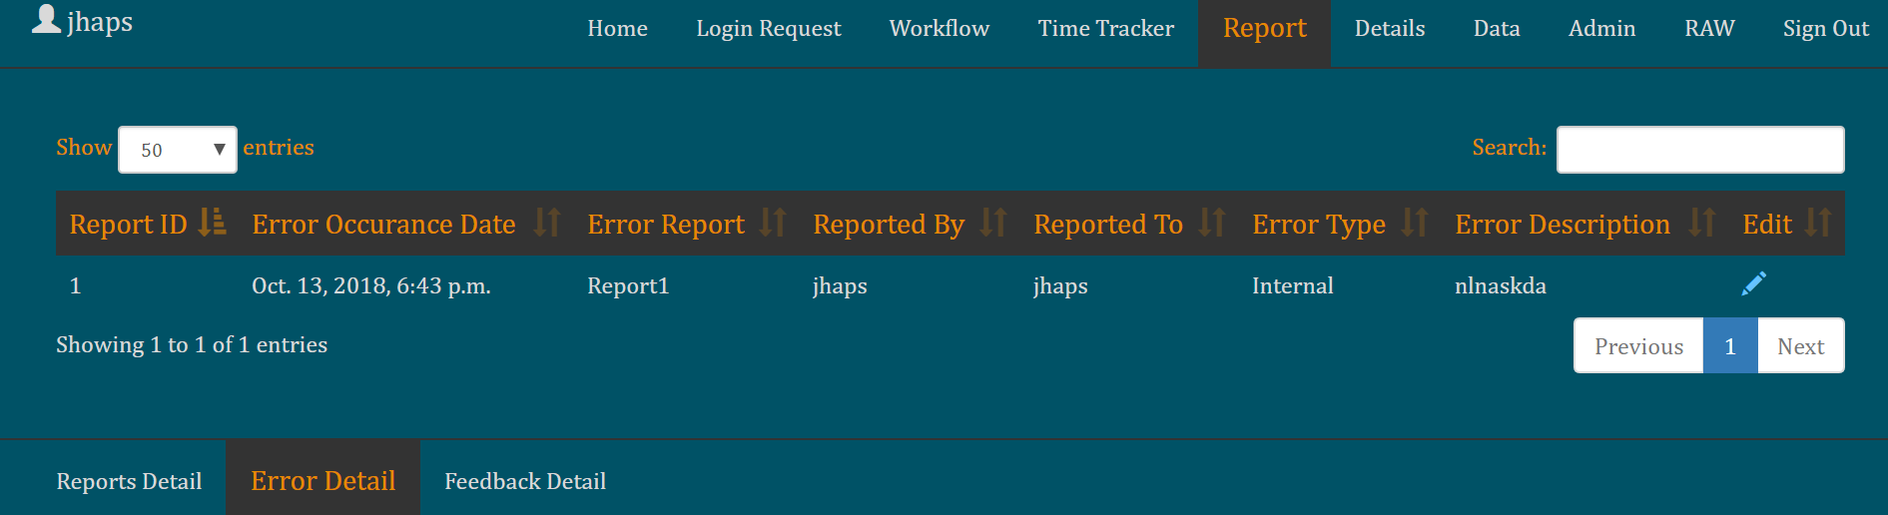
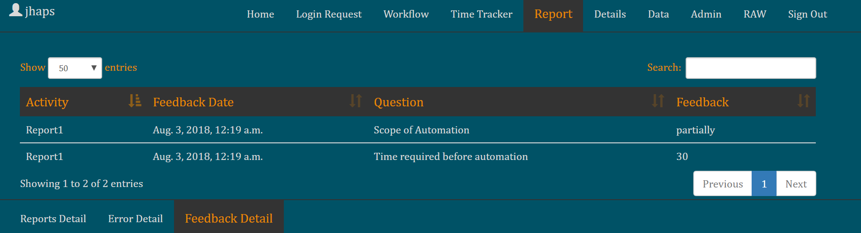
Home
Login Request
Workflow
Time-Tracker
Report
Details
Data
Admin
RAW
Reports Detail:
One can view the report detail, however you can also add new report. One can add Error on any specific report also one can add Feedback of the BU on any specific report
Error Detail:
One can find all the error detail from this tab
Feedback Detail:
Once can find all the feedback given by BU on the reports

Slide 10
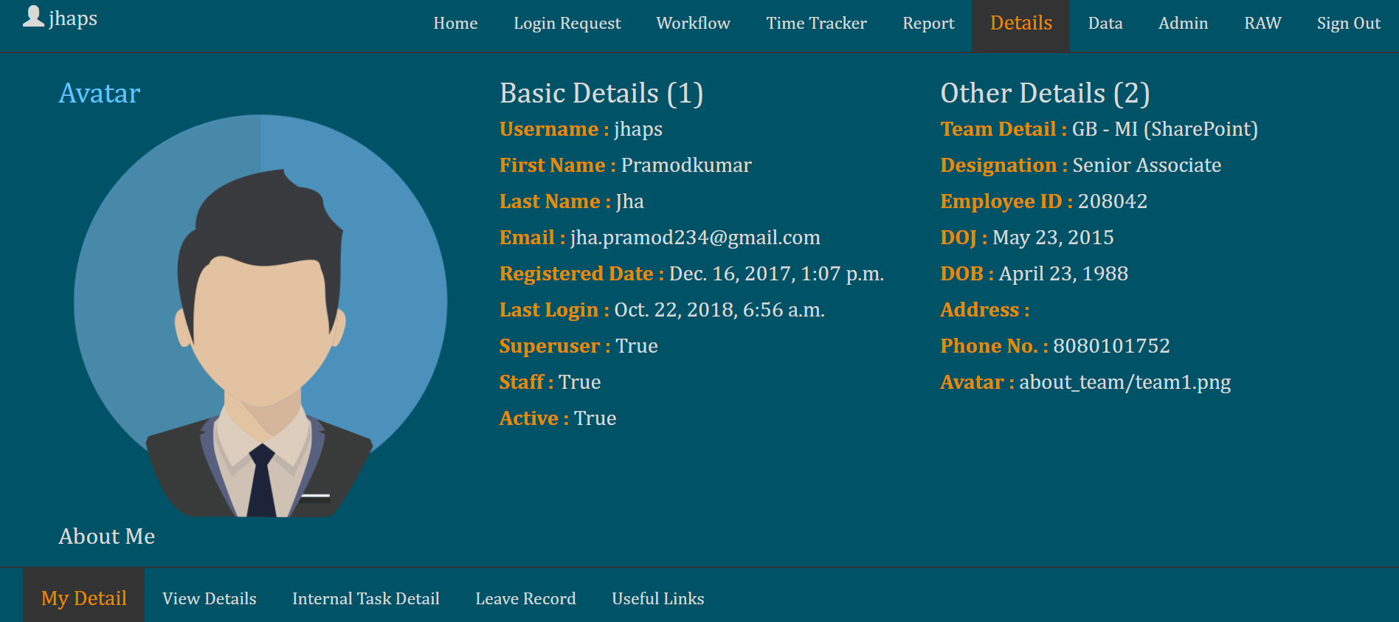
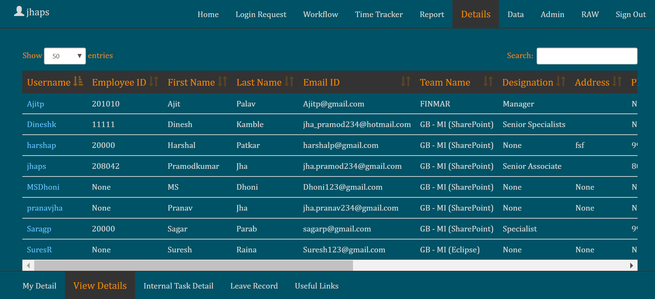
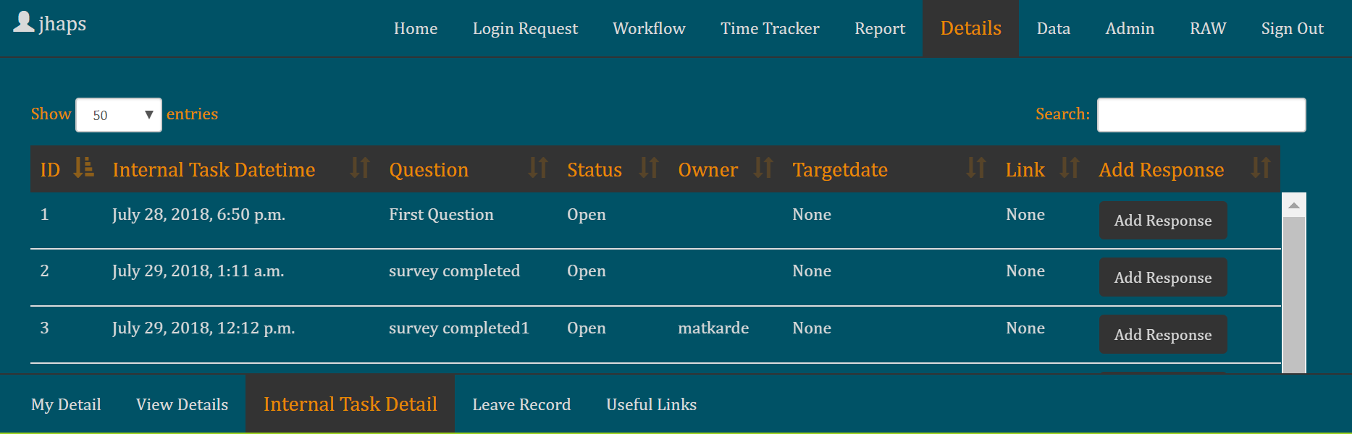
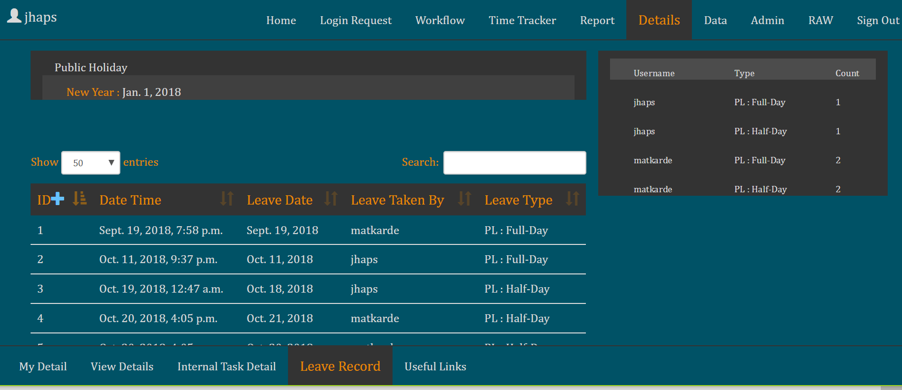
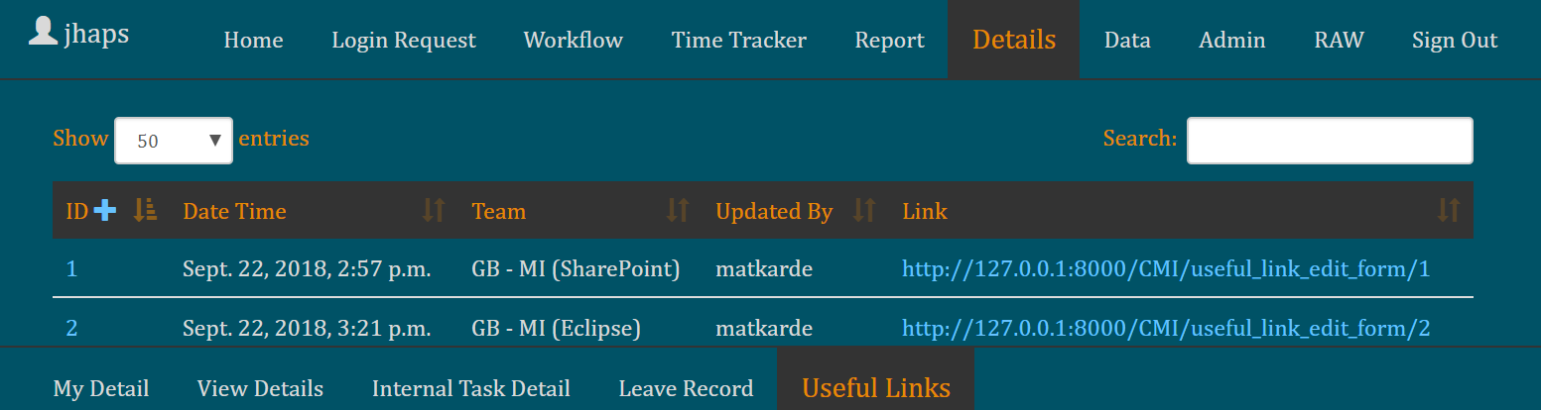
Home
Login Request
Workflow
Time-Tracker
Report
Details
Data
Admin
RAW
My Detail: It is the place one can add or edit their information, available on site
View Detail: It is the place one can add or edit others few key information, as this view is available to a specific group and not to all
Leave Record:
User need to update his leave, this to get the utilization right. To exclude leaves dates from utilization calculation
Internal Task Detail: It is place one can add question with choices to respond ( like a survey), only specific group can add the question however anyone can respond from Mi Team
Useful link:
Team can add useful and handy link at one place

Slide 11
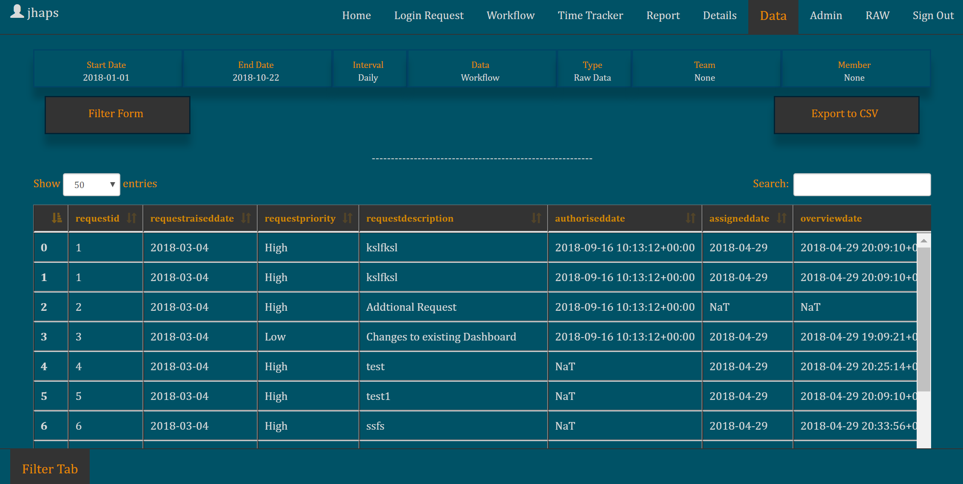
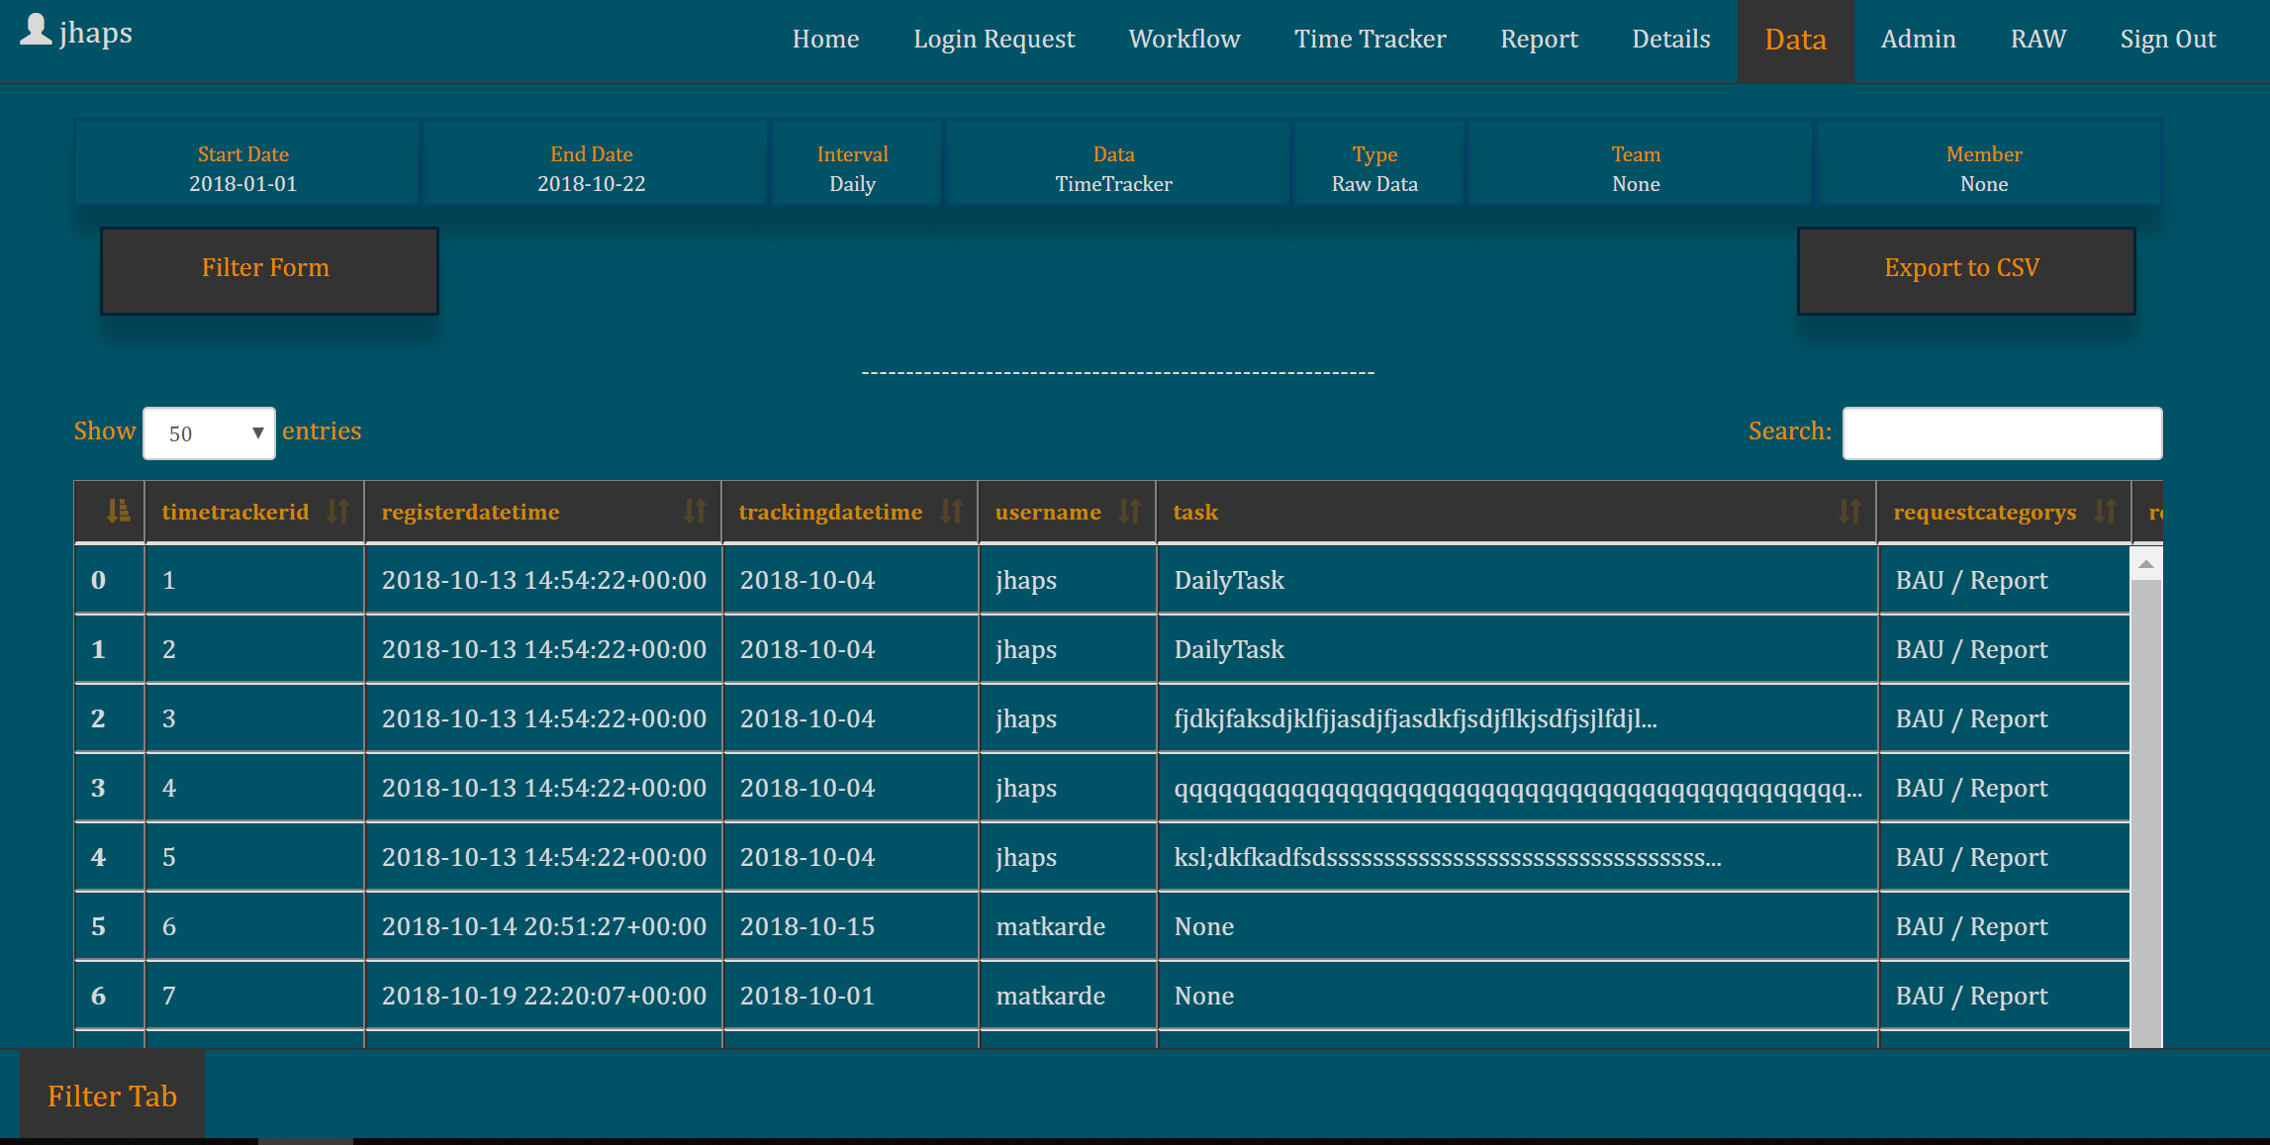
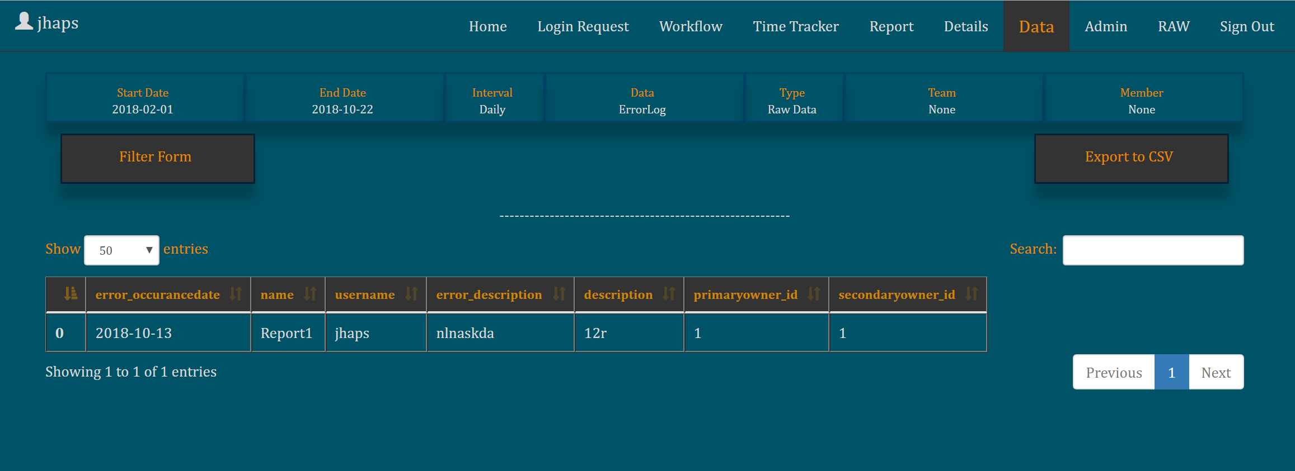
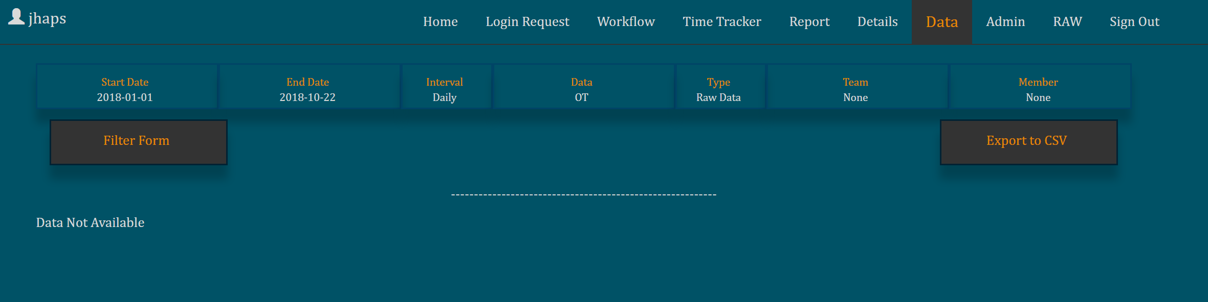
Home
Login Request
Workflow
Time-Tracker
Report
Details
Data
Admin
RAW
Filter Tab: Raw Report (Workflow)
Filter Tab: Raw Report (TimeTracker)
Filter Tab: Raw Report (Error Log)
Filter Tab: Raw Report (OT)

Slide 12
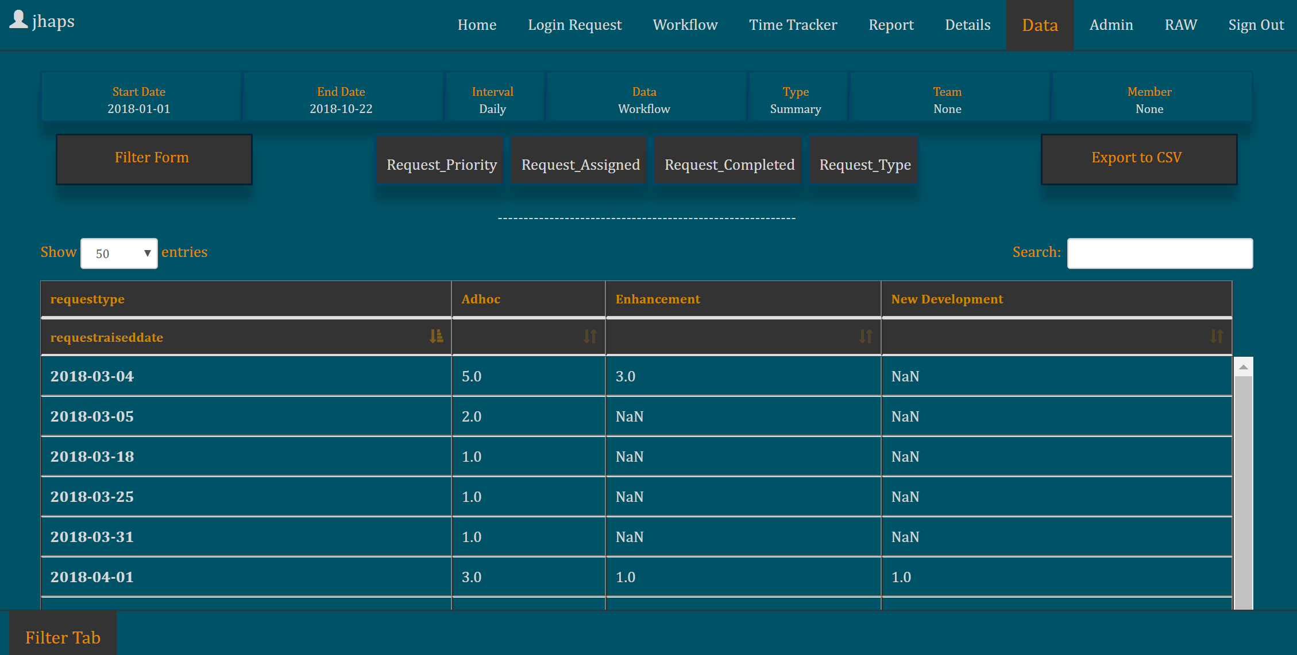
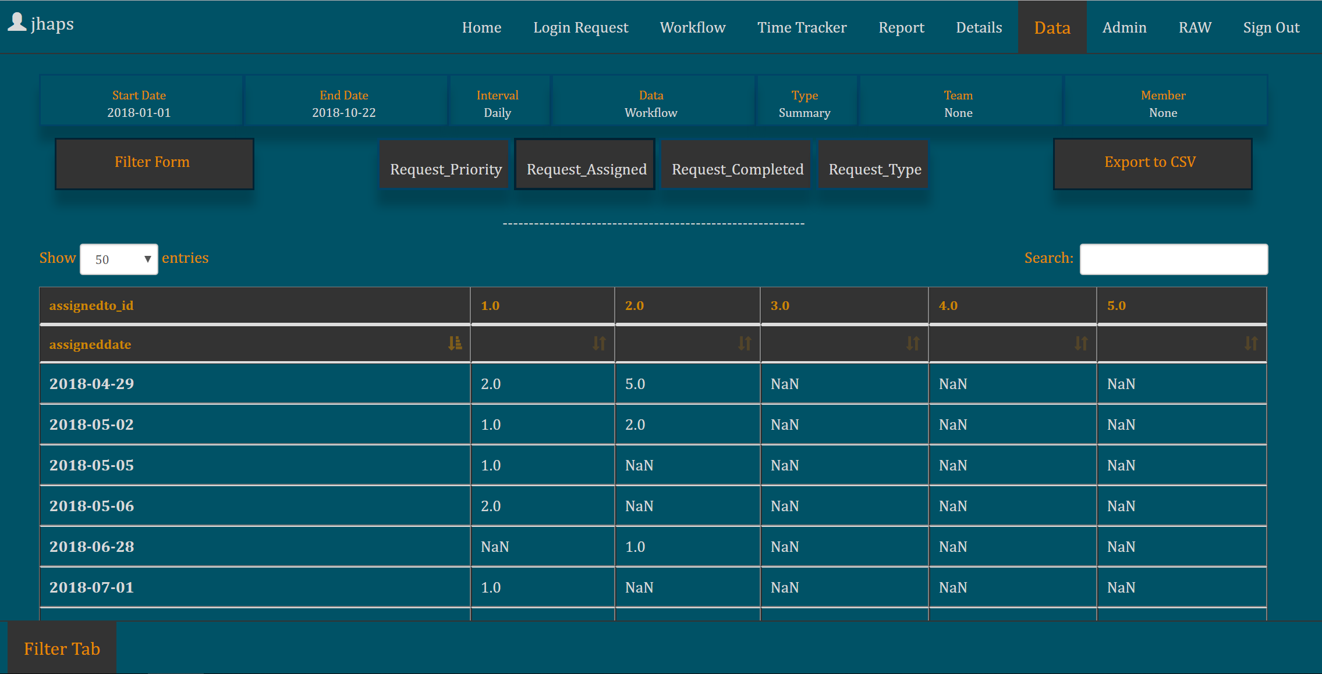
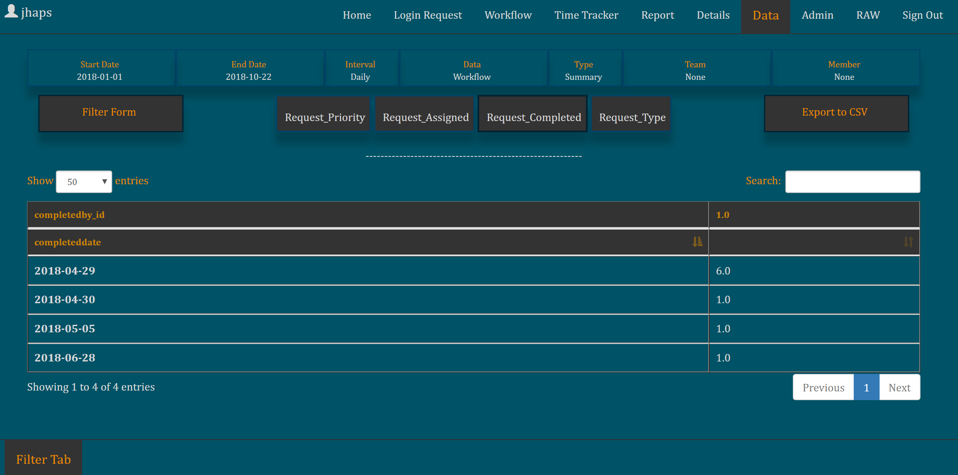
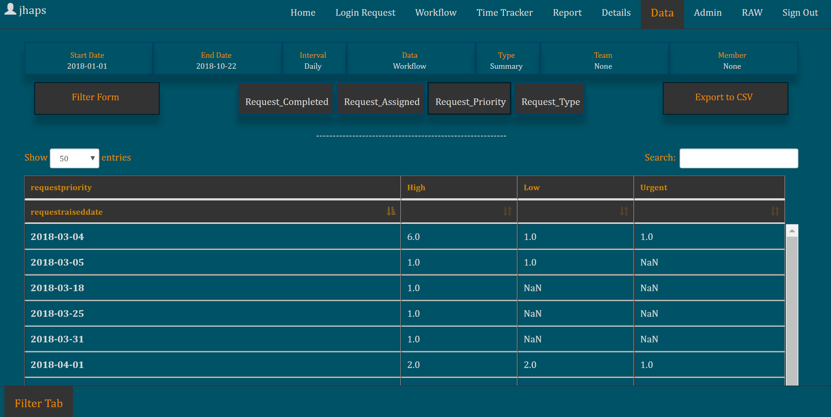
Home
Login Request
Workflow
Time-Tracker
Report
Details
Data
Admin
RAW
Filter Tab: Summary (Workflow) – by default ‘Request Type’ view get’s shows up
Filter Tab: Summary (Workflow) – ‘Request Assigned’ view
Filter Tab: Summary (Workflow) – ‘Request Completed’ view
Filter Tab: Summary (Workflow) – ‘Request Priority’ view

Slide 13
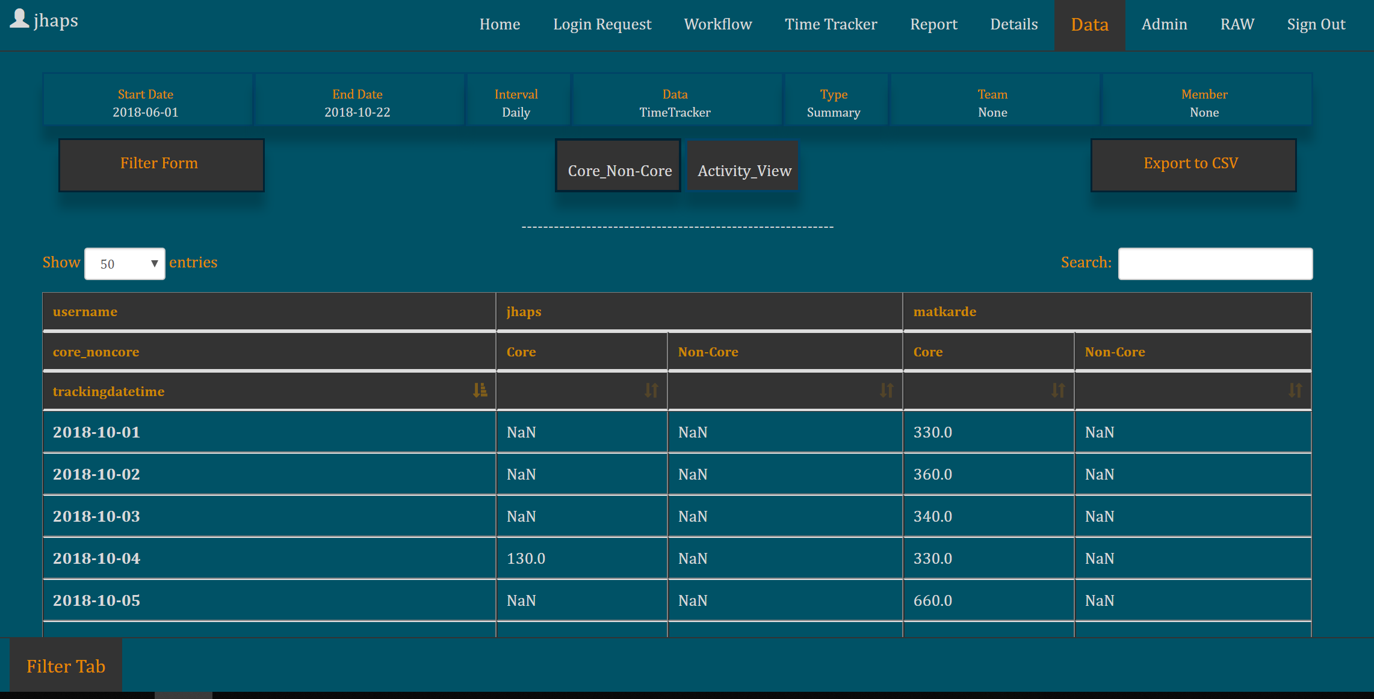
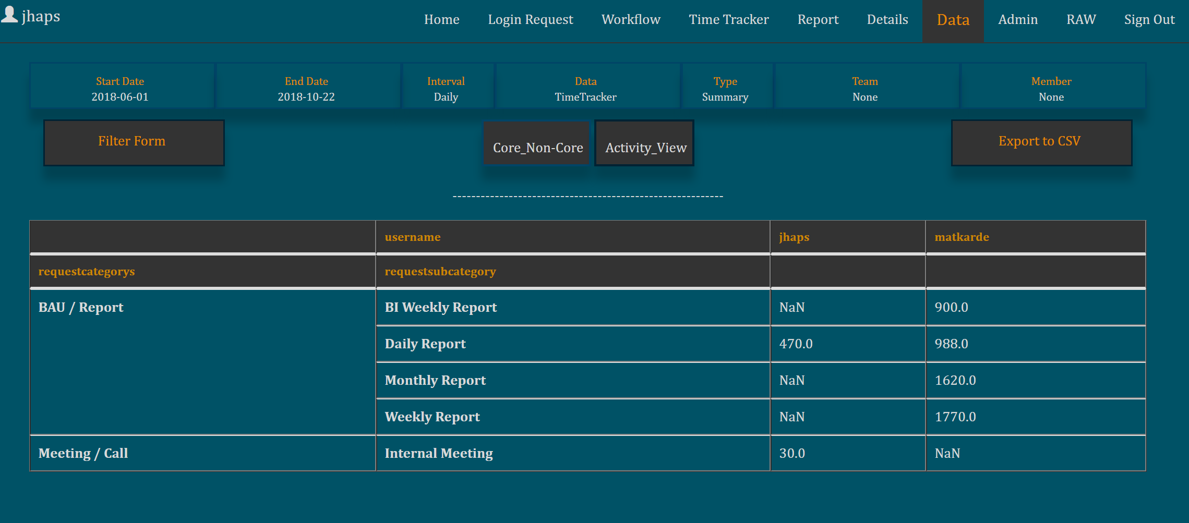
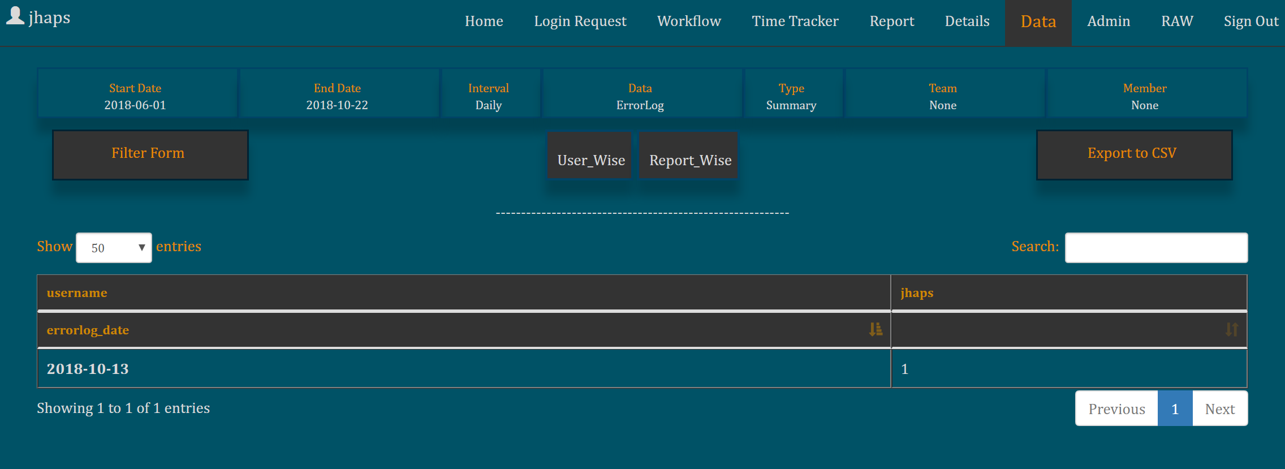
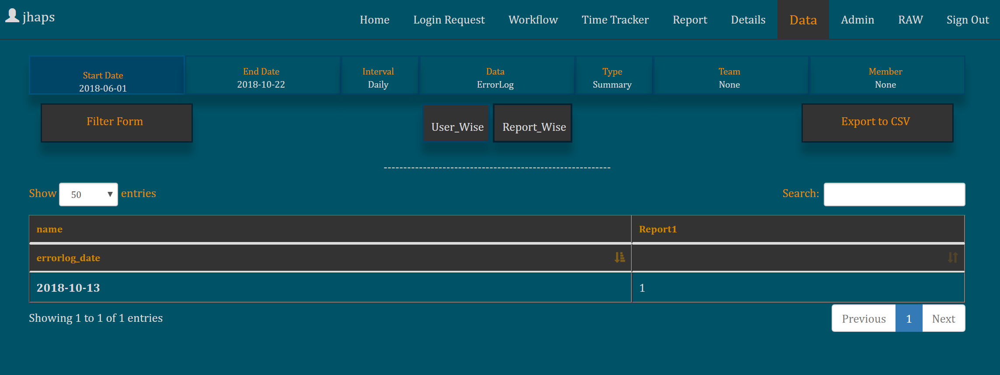
Home
Login Request
Workflow
Time-Tracker
Report
Details
Data
Admin
RAW
Filter Tab: Summary (Time-Tracker) – by default ‘Core NonCore’ view
Filter Tab: Summary (Time-Tracker) – ‘Activity’ view
Filter Tab: Summary (Error) – by default ‘User Wise’ view
Filter Tab: Summary (Error) – ‘Activity Wise’ view

Slide 14
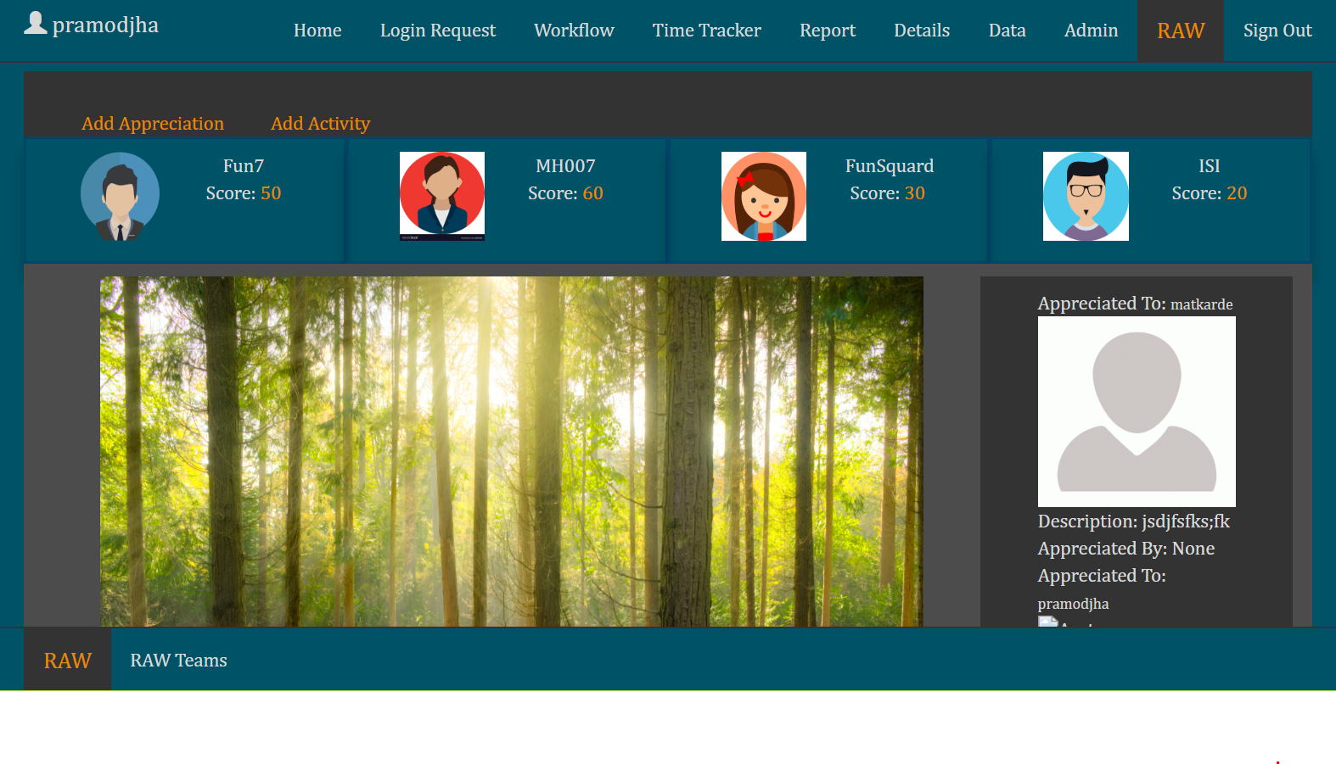

Home
Login Request
Workflow
Time-Tracker
Report
Details
Data
Admin
RAW
Raw Team:
Raw Team can add appreciation, fun activity, team scores in this page.
Raw Team:
This page display teams name and their member created by Raw Team.

Slide 15

View Info based on Groups

Slide 16
Technology Used:
Language: Python
Web Framework: Django
Styling: HTML/CSS/JavaScript
AJAX used
Effort:
Weekend in 10 months = 10 * 8 = 80
Worked ~ 75% of Weekend = 80 * 0.75 = 60 days
So to achieve current status it took ~2 Month.

